Slide 1
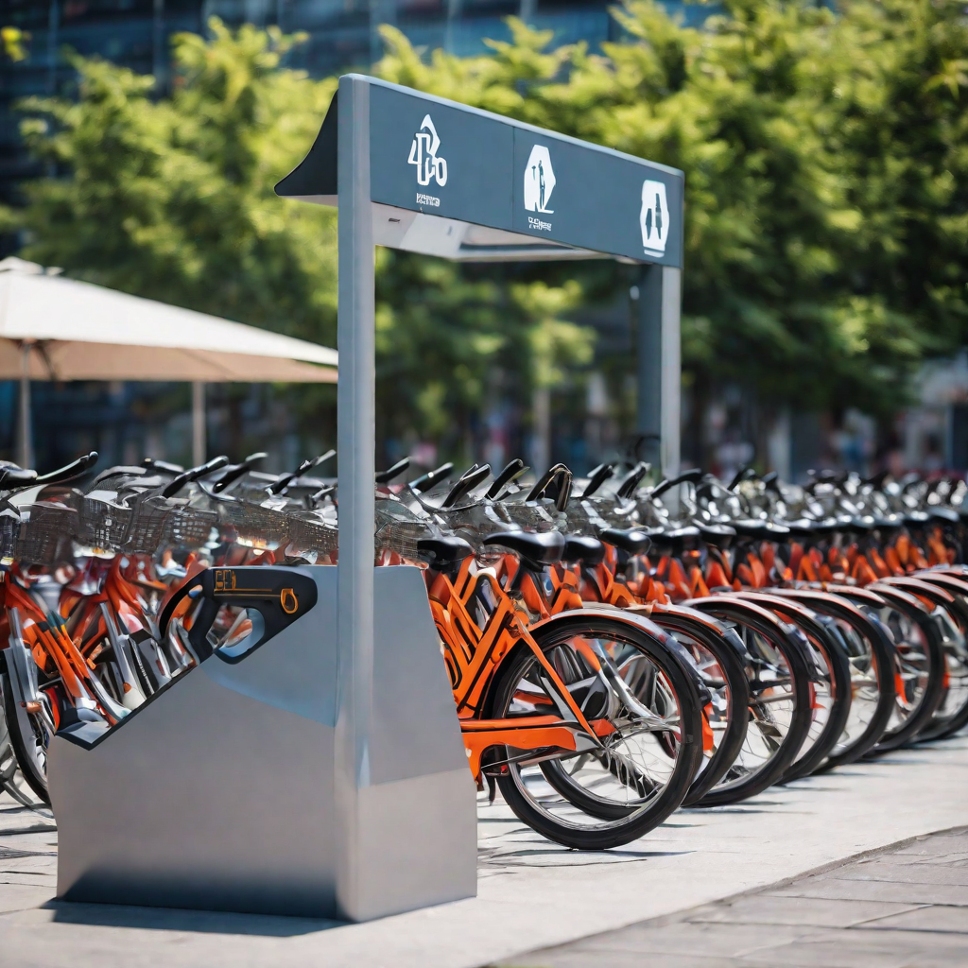
Bike Sharing Demand Prediction Presented by : DOLLY BAGHEL

Slide 2
Problem Statement
In the context of urban mobility enhancement through rental bikes, the challenge lies in ensuring the timely availability and accessibility of bikes to the public. To achieve this, it is imperative to accurately predict the demand for rental bikes at each hour. The primary problem is the uncertainty in determining the required bike count at various time intervals, which directly impacts the stability of the rental bike supply in the city. A precise prediction model is essential to optimize the distribution and maintenance of bikes, minimizing waiting times for users and ensuring a consistent and reliable supply of rental bikes throughout the day. The objective is to develop a robust prediction system that anticipates the hourly demand for rental bikes, contributing to the efficient management of urban mobility resources and enhancing overall user experience.

Slide 3


Data Collection & Preprocessing
Data Collection
We collected data on bike sharing usage from various cities around the world. This data included the number of bikes rented, the time of rental, and the location of the bike sharing station. We also collected data on weather conditions, holidays, and events that may affect bike sharing usage.
Preprocessing
The collected data was preprocessed to ensure it was in a usable format for our predictive models. This involved cleaning the data, handling missing values, and transforming the data into numerical values. We also performed feature engineering to extract relevant features from the data that may impact bike sharing usage.

Slide 4
Exploratory Data Analysis
In order to understand the data and identify any patterns or trends, exploratory data analysis (EDA) was conducted on the bike sharing usage dataset.
The first step in EDA was to check for missing or incorrect data. It was found that there were no missing values or outliers in the dataset.
Next, the distribution of the target variable (number of bike rentals) was examined. It was found that the distribution was slightly skewed to the right, with a few days having significantly higher rental counts than the rest of the days.
The relationship between the target variable and the other variables in the dataset was also explored. It was found that the variables 'temperature', 'humidity', and 'windspeed' had a significant correlation with the number of bike rentals

Slide 5
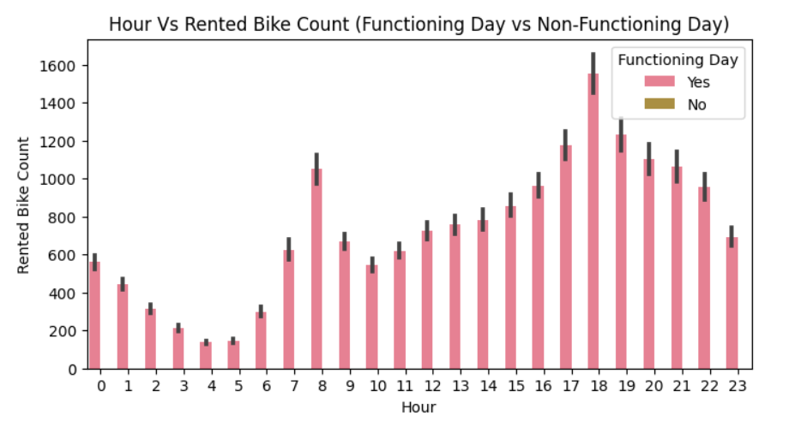
This is a visual analysis of how the count of rented bikes varies across different hours of the day, with an additional layer of information provided by the distinction between "Functioning Day" and "Non-Functioning Day." This can help in identifying patterns, trends, or differences in bike rental behavior during different times and under different operational conditions.

Slide 6
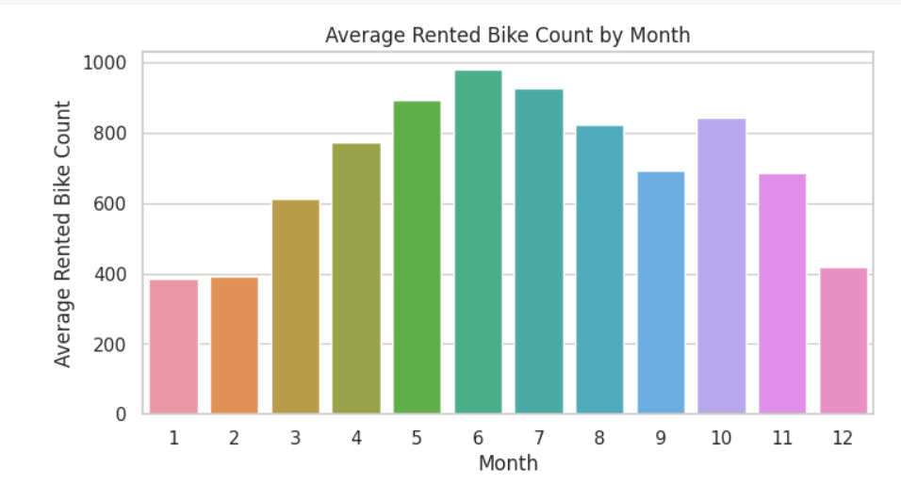
This is a visual analysis of how the average rented bike count varies across different months, providing insights into seasonal patterns or trends in bike rental activity.
People rented most bike in 6th month(june) followed by 7th(july) and 5th(may) month
Less bike rented in months having cold weather 1st(Jan), 2nd(Feb) and 12th(Dec) month

Slide 7
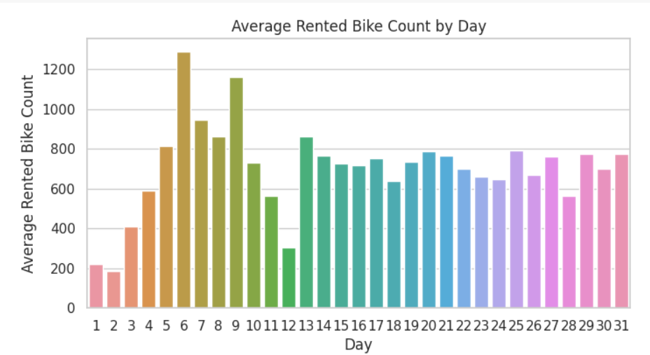
This is a visual analysis of how the average rented bike count varies across different days of the week, providing insights into weekly patterns or trends in bike rental activity.
People rented most bike on 6th day of the month and least on 1st and 2nd

Slide 8
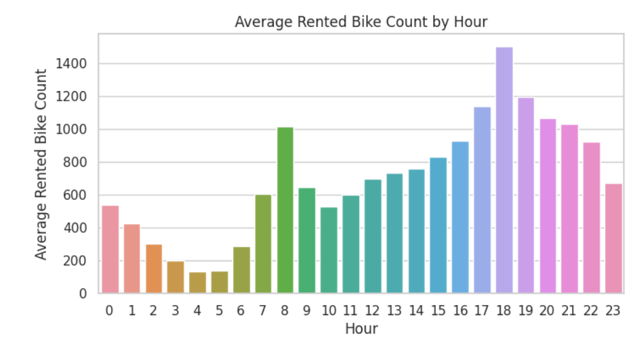
This is a visually analyzes how the average rented bike count varies throughout the day, providing insights into hourly patterns or trends in bike rental activity.
Most bike were rented from 5pm to 7pm
Least bikes were rented from 1am to 6am

Slide 9
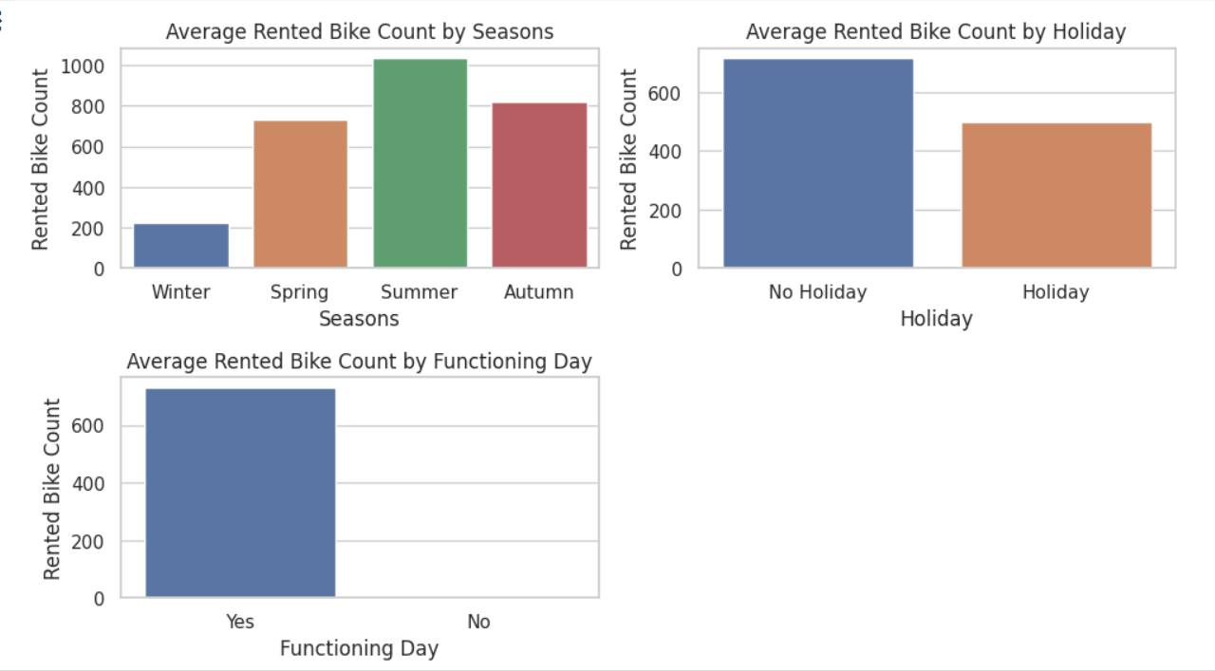

Slide 10
Feature Engineering
Feature engineering is the process of selecting and transforming raw data into features that can be used by machine learning models. In the context of bike sharing usage prediction, this involves identifying the most relevant data points and creating new features that capture meaningful patterns and trends.
Temporal Features
One important aspect of bike sharing usage is the temporal nature of the data. Features that capture time-related patterns can be very valuable for predicting usage. Some examples of temporal features include:
Hour of the day: bikes might be used more during rush hour or at night.
Day of the week: weekdays might have higher usage than weekends.
Month of the year: bike usage might be higher during warmer months.
Weather Features
Weather can also have a significant impact on bike sharing usage. Including weather-related features can improve the accuracy of the model. Some possible weather features include:
Temperature: warmer weather might lead to higher usage.
Precipitation: rainy or snowy days might lead to lower usage

Slide 11
Model Selection The model selection process involved trying out different machine learning algorithms and evaluating their performance on the bike sharing usage prediction task. We focused on models that could handle both numerical and categorical data, as well as models that could capture time series patterns.
Linear Regression
We started with a simple linear regression model, which assumes a linear relationship between the predictors and the target variable. This model performed poorly on our data, likely due to the non-linear patterns in the time series data.
Random Forests
We then tried a random forest model, which is an ensemble of decision trees. This model was able to capture non-linear patterns in the data and performed better than linear regression. However, it tended to overfit the training data and had high variance.
Gradient Boosting:
Next in our modeling exploration, we implemented a Gradient Boosting model—a powerful ensemble learning technique. Similar to Random Forests, Gradient Boosting combines the strength of multiple weak learners (typically decision trees) to create a robust predictive model. This approach sequentially builds a series of trees, each compensating for the errors of its predecessor.

Slide 12

Model Evaluation To evaluate the performance of our bike sharing usage prediction model, we used a variety of metrics including mean squared error, root mean squared error, and R-squared.
Mean Squared Error (MSE)
The MSE measures the average squared difference between the predicted and actual values. A lower MSE indicates better model performance.
R-squared
R-squared measures the proportion of variance in the dependent variable that is explained by the independent variables. A higher R-squared indicates a better fit between the model and the data.

Slide 13
Results & Conclusions
After analyzing the data and running multiple models,we have come to the following conclusions
The most important factors in predicting bike sharing prediction are weather condition,Temperature,hour and functioning day.
Our best performing model was XGBoost with accuracy score of 0.919
We can confidently predict bike sharing usae with accuracy of 91%.
In conclusion, our analysis has shown weather conditions, Temperature,hour and functioning day are the most important factors in predicting bike sharing usage.By using our XGBoost model, we can accuratelypredict bike sharing usage with an accuracy rate of 91%.These results can be used to improve bike sharing services and optimize resources for better customer satisfaction.

Slide 14
Recommendations & Future Work
Recommendations
Based on our analysis, we recommend that bike sharing companies focus on expanding their services to areas with high demand, particularly during peak rental times. Additionally, companies should consider implementing dynamic pricing strategies to incentivize users to rent bikes during off-peak hours.
Future Work
In the future, we plan to further refine our model by incorporating real-time weather data and other external factors that may impact bike rental demand. We also plan to explore the use of machine learning algorithms to improve the accuracy of our predictions.

Slide 15
Thank You Presented by:- DOLLY BAGHEL

